Slide 1
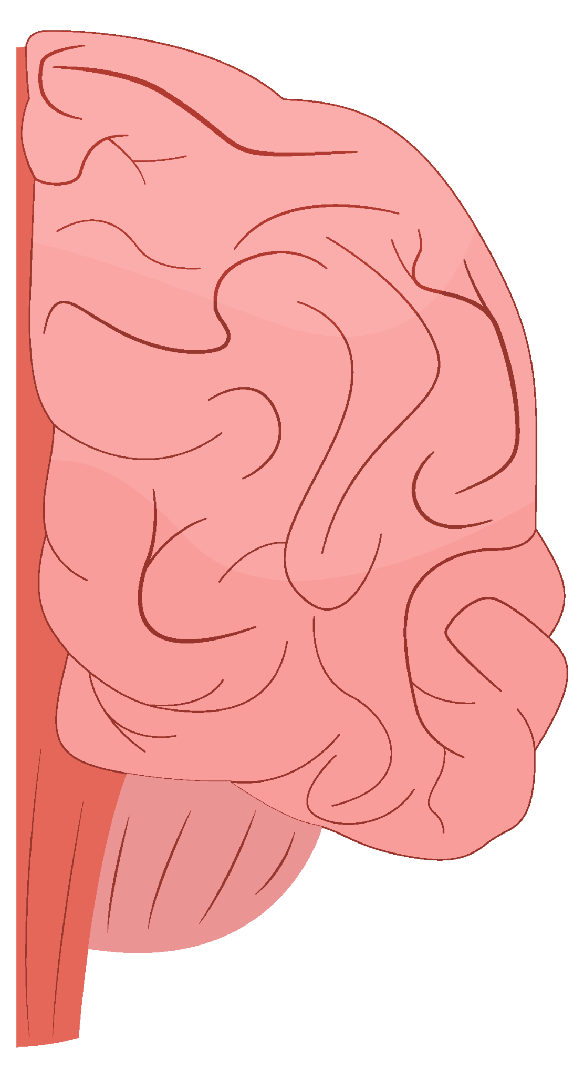
Brain Tumor Classification
By Maria Estrada and Mauren Vasquez

Slide 2
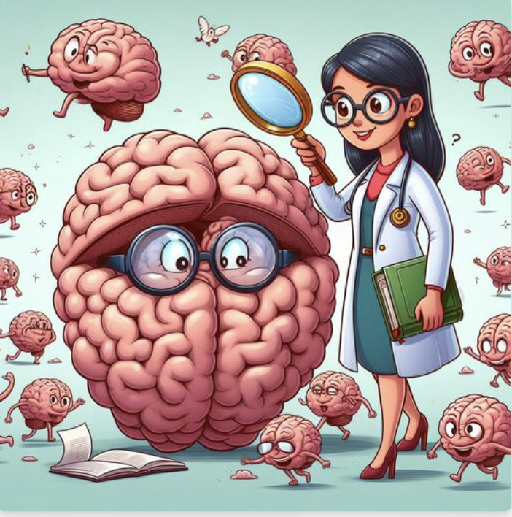
Introduction
Brain tumors are among the most perilous diseases, demanding early and precise detection methods.
Currently, most detection and diagnosis methods rely on the assessments of neuro-specialists and radiologists for image evaluation, which can be prone to human errors and are time-consuming.
The primary aim of our project is to develop a CNN model capable of classifying whether a subject has a tumor or not, based on MRI scan images.
Notes:
Why is time important.
a patient has to wait 3 – 6 weeks with normal technology
Eg. Glioblastoma
The most deadly form of brain cancer
Double its size in just 14 days
Average survival time: 8 month

Slide 3




IBM Watson Health Imaging
IBM has developed AI-driven tools that help in analyzing medical imaging, including MRIs of the brain. Their software can assist in identifying abnormalities and providing quantitative data that can be critical in diagnosis and treatment planning.
GE Healthcare's Edison Platform
Developed by Google’s DeepMind, this AI system has demonstrated proficiency in identifying different types of brain cancers by analyzing MRI scans.
Siemens Healthineers' AI-Rad Companion
his platform uses AI to provide tools that help improve the efficiency of image processing and analysis, including brain scans. Edison can assist in detecting and characterizing tumors within the brain.
Aidoc's AI Solutions
Known for providing always-on AI solutions for radiologists, Aidoc's technology can flag acute abnormalities in real time on brain scans, which helps in prioritizing urgent cases.

Slide 4
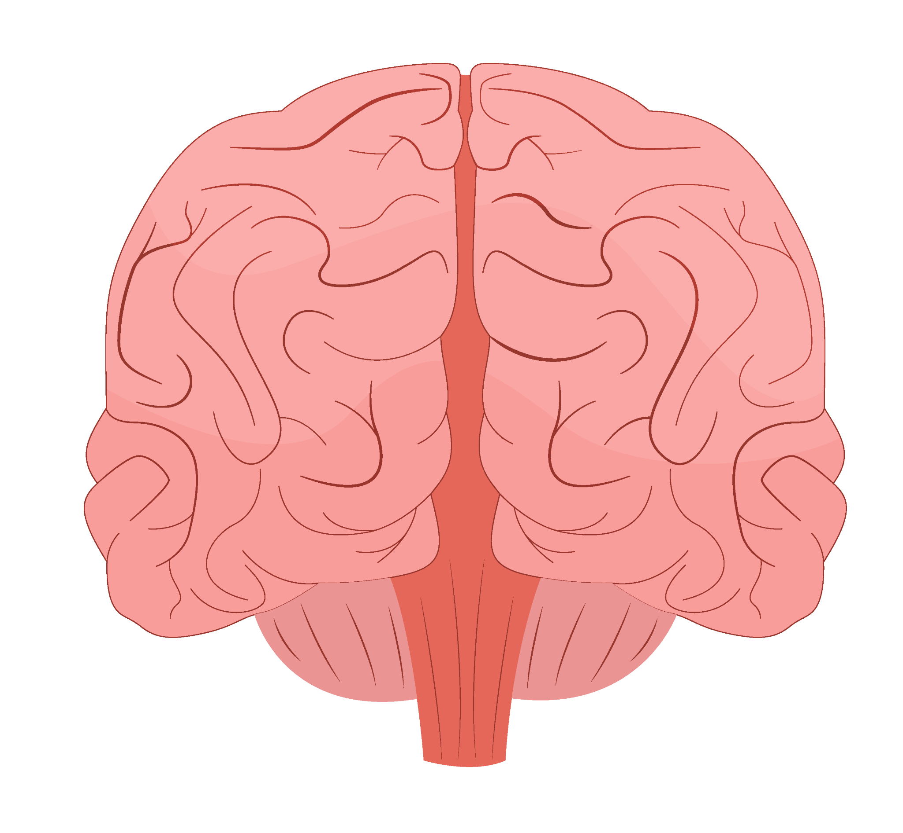
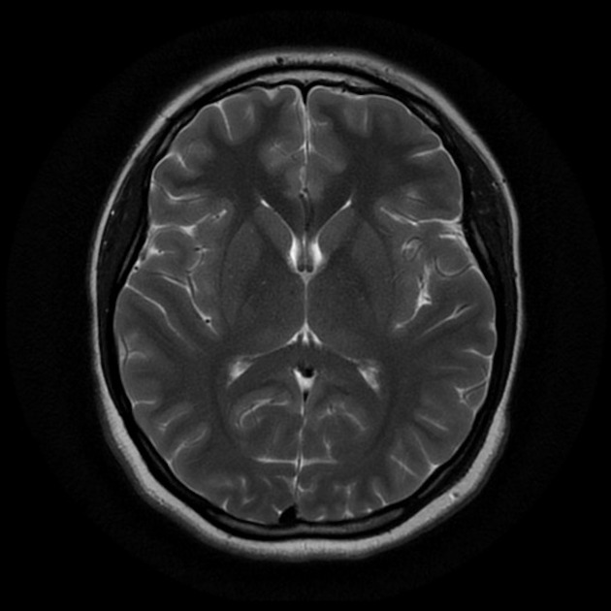
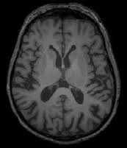
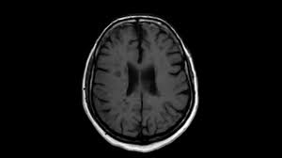
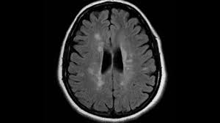
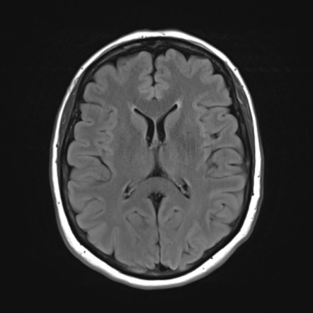
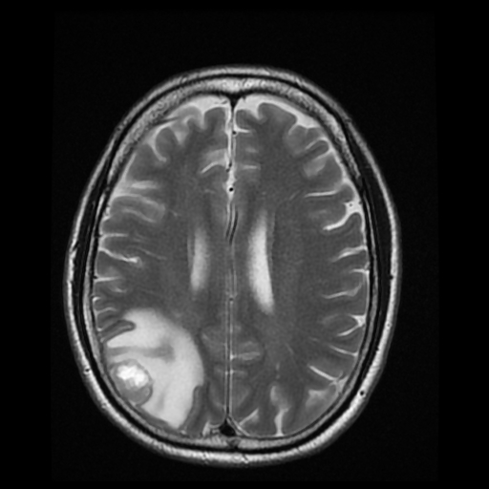
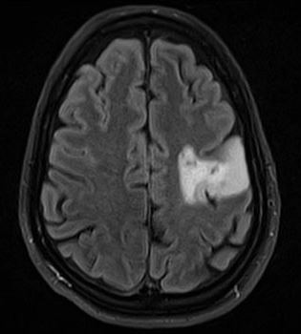
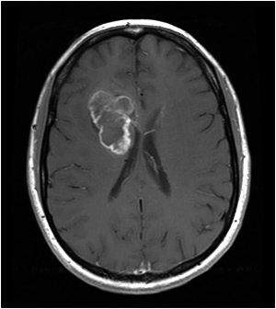
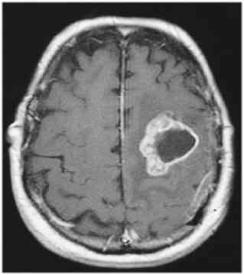
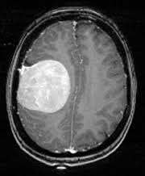
Data
Notes:
Total loaded Images :252
Images from: kaggle

Slide 5
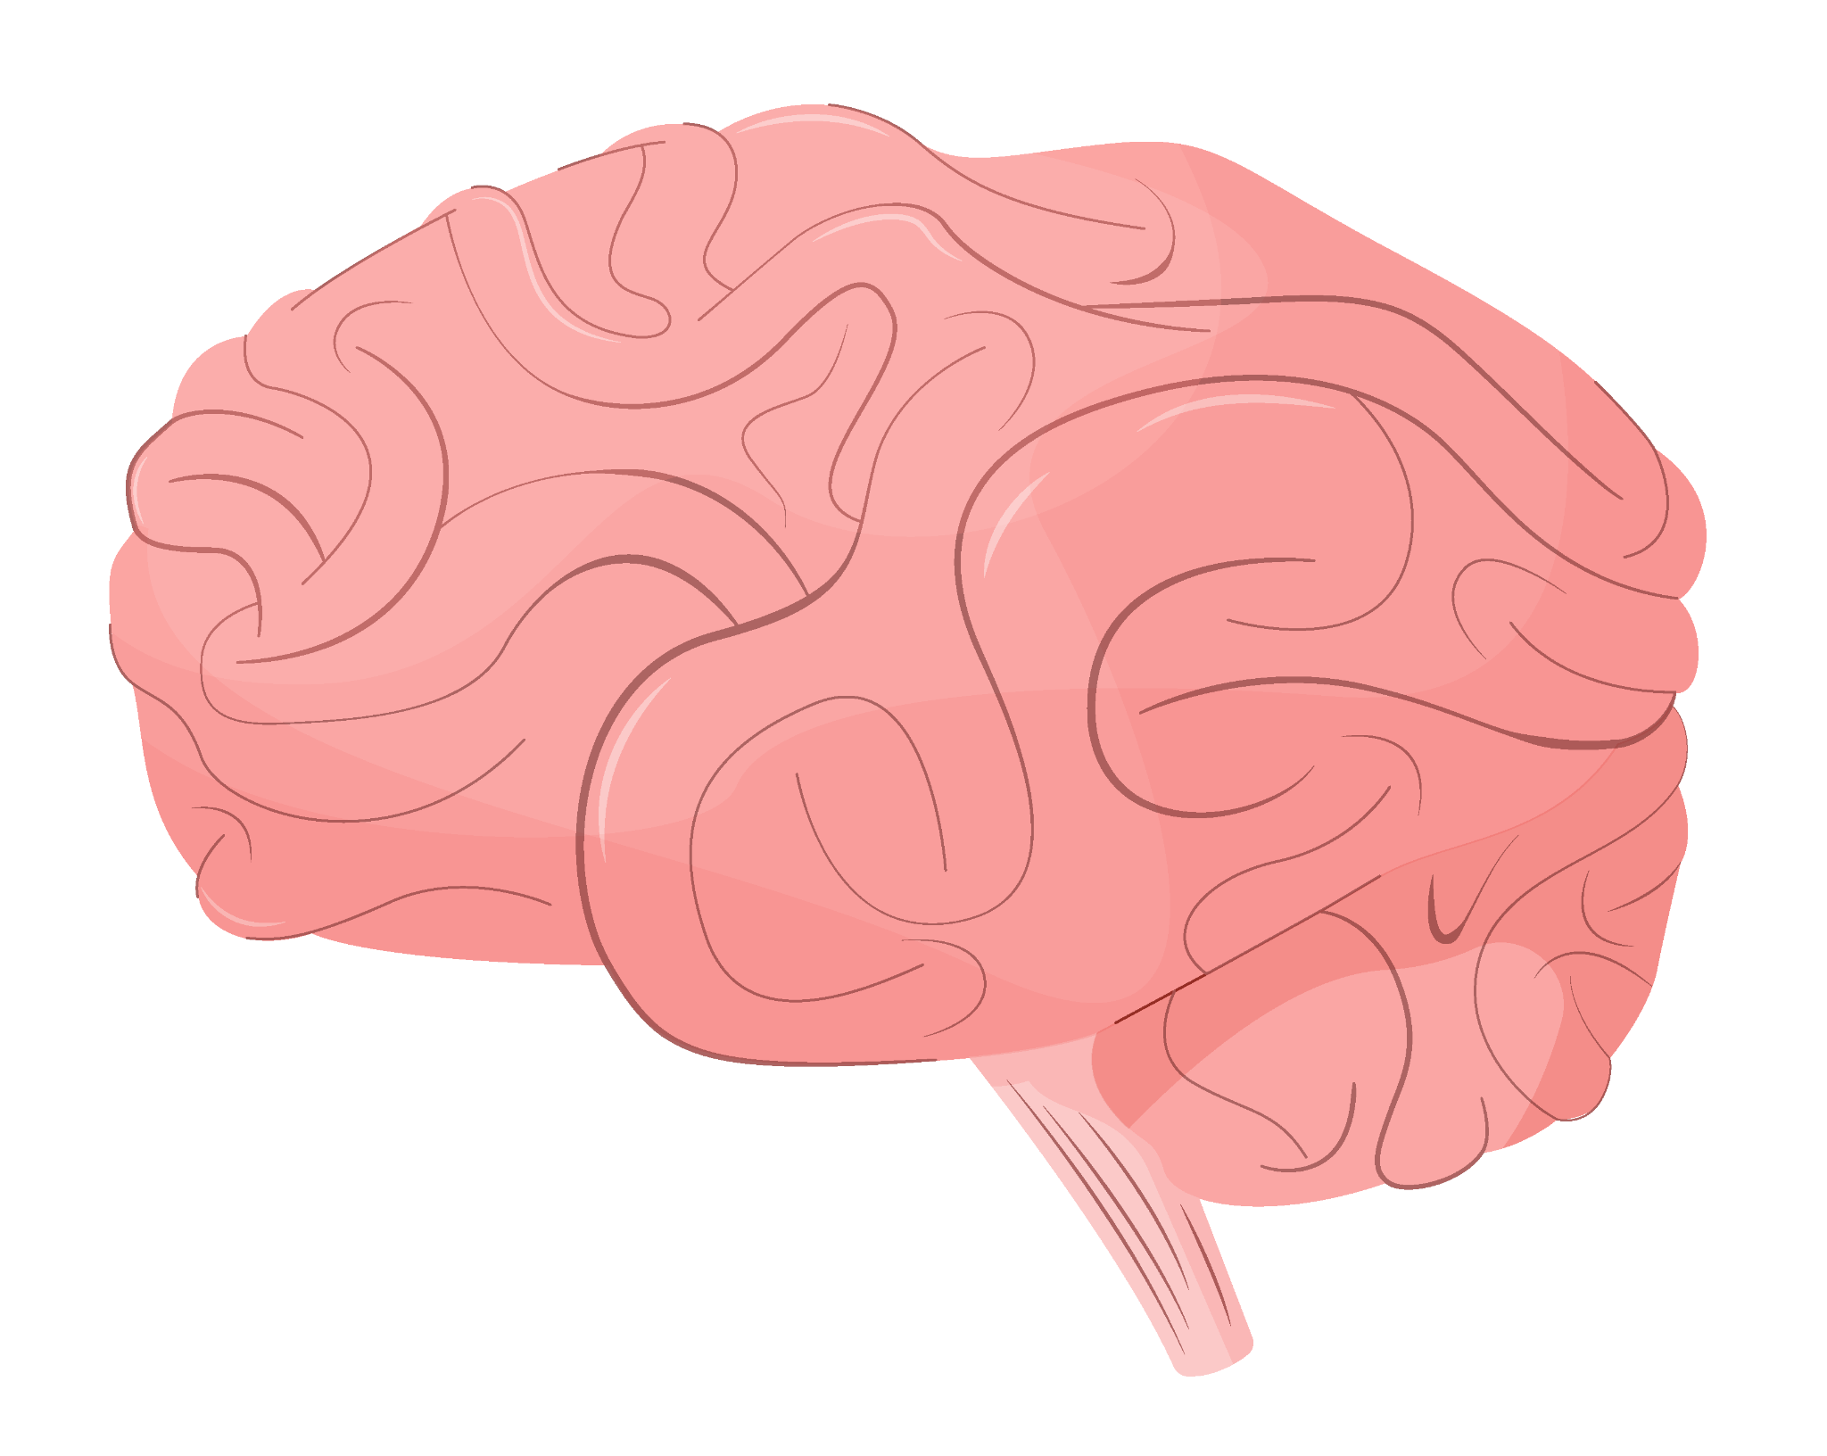
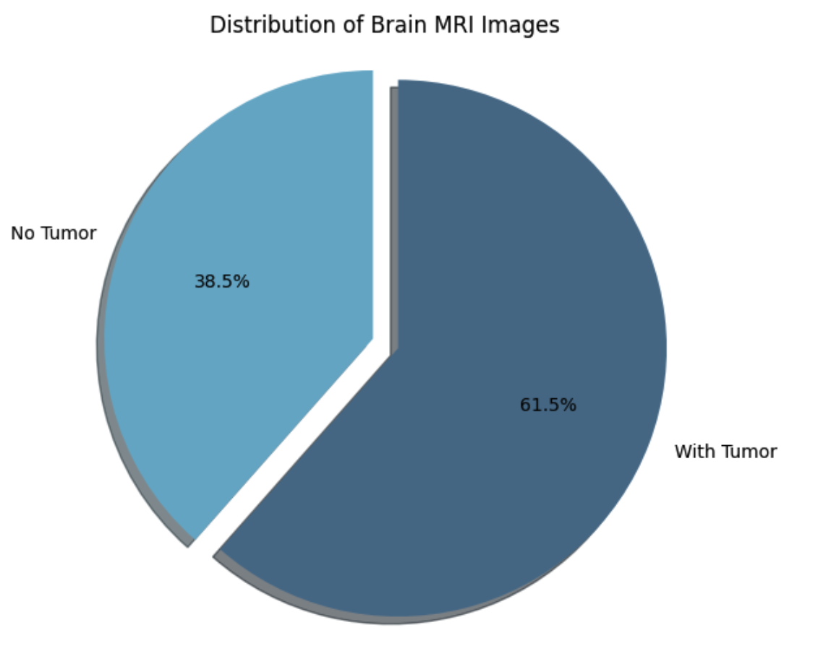
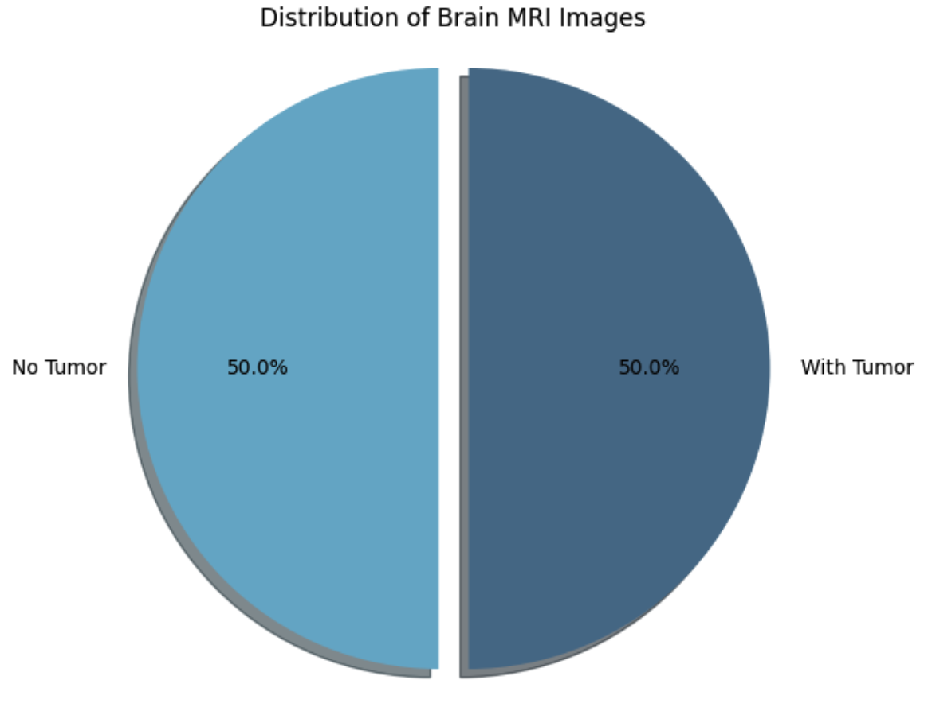
Clean Data
Normalization: scaling pixels from 0 - 255 to 0 – 1. For enhancing efficiency
Labeling images: 0 = No tumor and 1 = Tumor
Data Augmentation: To prevent overfitting and improve model generalization by increasing data variability by rating shifting and flipping images.
Original images 252+ Augmented images 58 = Total images 310
Notes:
Pie chart to visualize the distribution of brain MRI images based on whether they indicate the presence of a tumor or not

Slide 6
Why Use Convolutional Neural Networks?
Feature Learning: CNNs automatically detect and learn the most important features in the images without needing specific instructions on what to look for. This Very unique in medical imaging where subtle variations in tissue appearance can be seen in different types of pathology
Layered Processing: Images are processed through multiple layers where each layer focuses on learning increased complex features. Eg. Initial layers detect edges and​ basic shapes. Deeper layers are able to identify more complex structures like tumors or lesions.
Segments and classifications: CNNs can be used not only to detect the presence of a tumor but also the segment of the tumor.
Transfer Learning: Many medical imaging AI tools have pre-trained CNN models that are trained on large datasets and then fine-tuned on specific medical imaging datasets. This helps in achieving high accuracy even with smaller datasets.

Slide 7
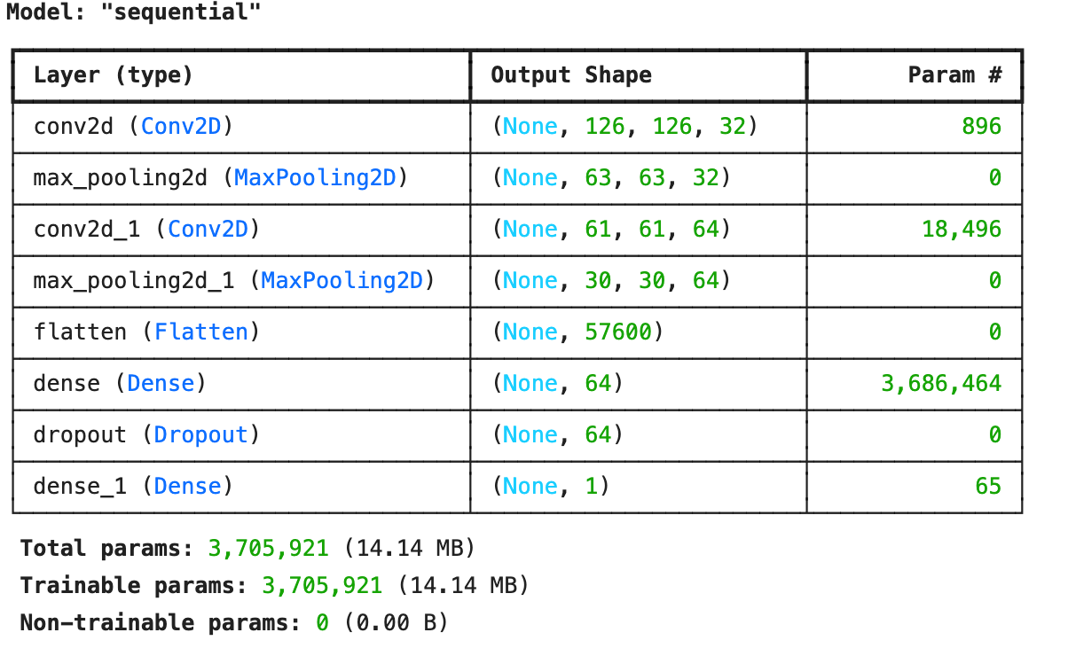
CNN for Classification
To improve the model's loss, I implemented L2 regularization, added the dropout rate, and removed Conv2D layers.
Notes:
What do the Layers do?
Lets find out!
conv2d_4 (Conv2D): For each image, the layer produces 32 different 126 x 126 feature maps
max_pooling2d_4 (MaxPooling2D):This layer reduces each feature map’s dimensions from 126x126 to 63x63.
conv2d_5 (Conv2D):This indicates that the layer outputs 64 feature maps, each of size 61x61.
max_pooling2d_5 (MaxPooling2D):It further reduces the size of each of the 64 feature maps from 61x61 to 30x30.
flatten_2 (Flatten):This flattens the 30x30x64 feature maps into a single 57600-element vector per image.
dense_4 (Dense): This fully connected layer has 64 output nodes.
dropout_2 (Dropout):The shape remains the same; it’s just that some neuron outputs are randomly set to zero during training.
dense_5 (Dense):This is the output layer for binary classification.

Slide 8
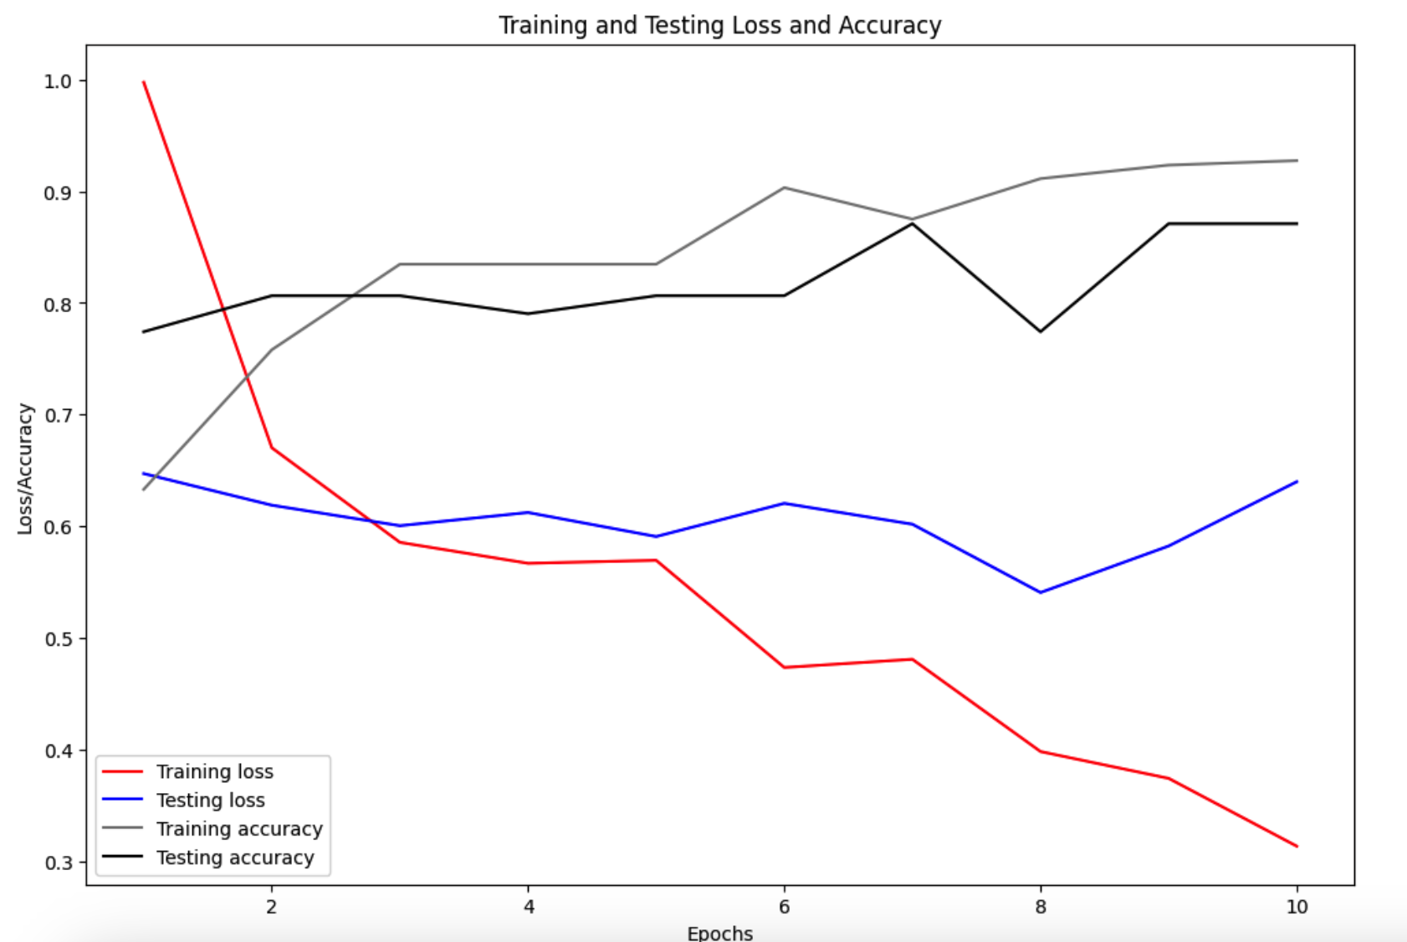
Evaluation
0.94
0.87
0.64
0.29

Slide 9
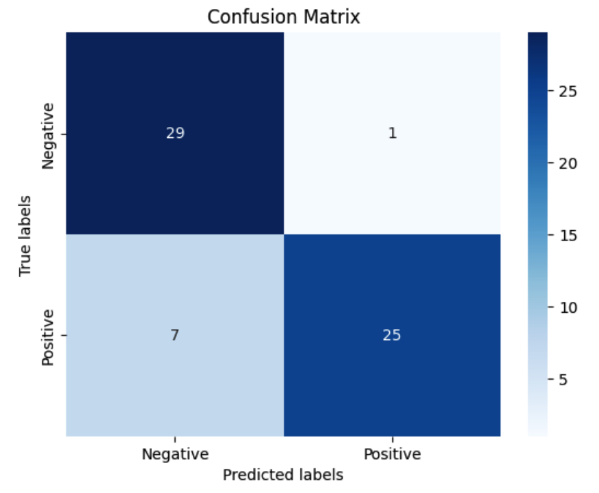
Evaluation

Slide 10
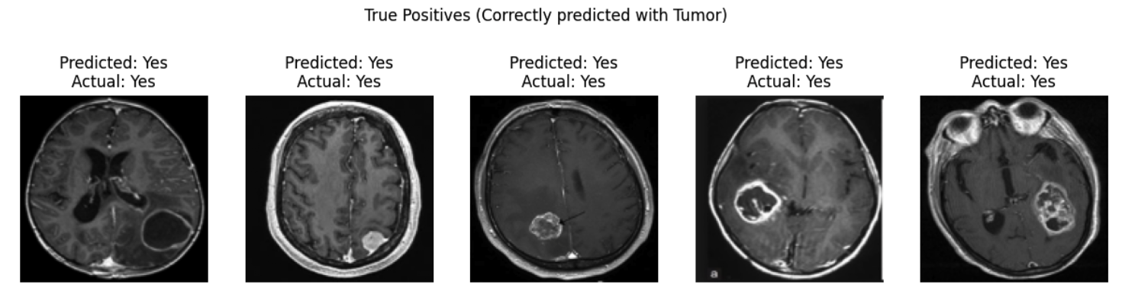
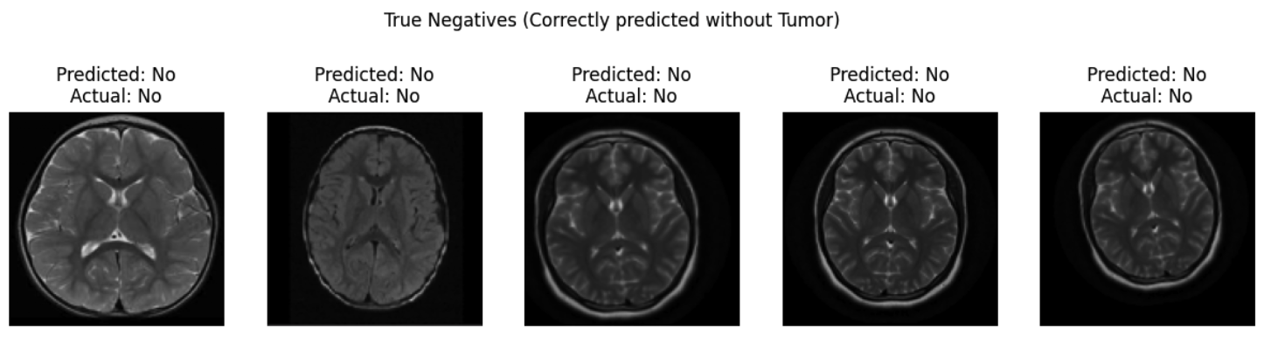
Evaluation

Slide 11
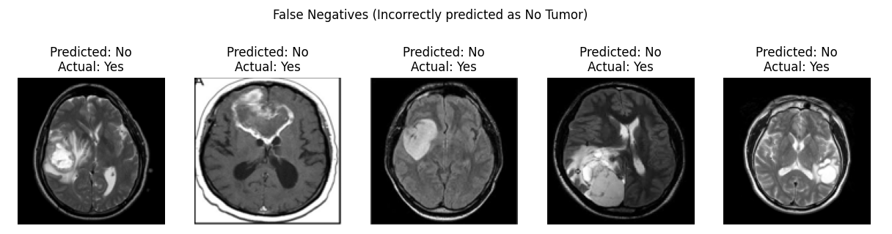
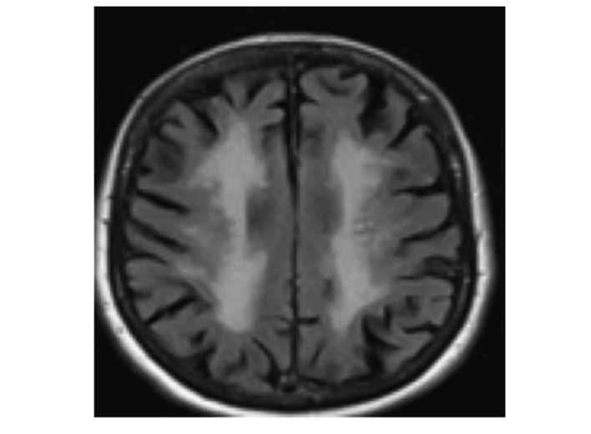
Evaluation
False Positives (Incorrectly predicted with Tumor)
Predicted: Yes
Actual: No

Slide 12
Conclusion
Getting or Finding More Data
Feature Engineering and Hyperparameter Tuning
Using Pre-Trained Models
U-Net for biomedical image segmentatio with pretrained weights for abnormality segmentation in brain MRI
Inception v3 is a convolutional neural network for assisting in image analysis and object detection
VGG-19 and VGG-16 convolutional neural network used for image classification, image recognition and object detection tasks

Slide 13
Thanks!
Do you have any questions?

Slide 14
Resources
Did you like the resources in this template? Get them on these websites:
Vectors
Brain function icons set with fear and joy symbols flat isolated vector illustration
Brain function set with stem and lobe symbols flat isolated vector illustration
Brain function background with art and science symbols flat vector illustration
Brain function infographic set with emotions and activity symbols flat vector illustration
Icons
https://www.flaticon.com/packs/central-nervous-system-4?word=neurology
Photos
https://www.kaggle.com/datasets/navoneel/brain-mri-images-for-brain-tumor-detection/data

